Slide 1
A STUDY ON THE LEACHABILITY OF METALS FROM MODIFIED COPPER SLAG FOR ADDED VALUE APPLICATIONS.
Jakob Kero
Jakob.kero@ltu.se
Ph.D. student in Process Metallurgy,
Luleå University of technology, Sweden

Slide 2
Outline
Background
Methodology
Results
Summary

Slide 3
Background - the project IQ slag
Project aims:
Broaden the application areas of copper slag
Quality assurance of the slag product/s
Slag modification
Lime, CaO
Compositions 2FeO-SiO₂ to CaO-FeO-SiO₂
Slag products
Composition
Leaching behaviour
Up to 25 wt. %
Process conditions
Cooling conditions
Parameters:
Flux
Innovative quality assured fayalite slag products

Slide 4
Background - the project IQ slag
Project aims:
Broaden the application areas of copper slag
Quality assurance of the slag product/s
Slag modification
Lime, CaO
Compositions 2FeO-SiO₂ to CaO-FeO-SiO₂
Slag products
Up to 25 wt. %
Parameters:
Process conditions
Cooling conditions
Composition
Leaching behaviour
Flux
Innovative quality assured fayalite slag products

Slide 5
Background – process overview
Pyrometallurgical copper extraction
SO₂- gas
Sulphuric acid
Cu-conc.
Cu-Fe-S
CaO
Pyrometallurgical processes
Smelting – converting - refining
Slag former SiO₂ , air, heat
Slag, FeO-SiO₂
Slag modification
Slag products
Secondary Cu-conc.
Cu-recycling
Electrorefining
Cu-metal

Slide 6
Scope of slag modification
Slag modification
CaO up to 25 %
Slag products
Analysis of slag products
Smelting
Semi-slow cooling
Feasibility study for industrial full-scale trials
Aims: Investigate possible process modifications - Amount of lime addition - Liquidus temperatures Lowering content and leachability of critical environmental elements in slag product
Lab-scale trials - slag modification
Characterisation of the crystalline slag samples Investigation of leaching behavior

Slide 7
Methodology
Smelting conditions
6 Samples CaO : 3.7 (0), 5, 10, 15, 20 and 25 wt. % Temp: 1250 °C Time: 2.0 hours Argon-atmosphere Al₂O₃- crucibles Cooling time: 4 hrs 24 min
Lab-scale trials
Evaluation
Evaluation methods
Slag sample
Chemical analysis
Smelting
Characterisation
XRD powder diffraction
Slag products
SEM-EDS
Leaching conditions
Batch leaching test, EN12467-2 Remelted samples Liquid/solid: 10 Time: 24 hours Filtration of eluate: 0.45µm filter
Leaching test EN12467-2
ICP-OES Element analysis of eluate

Slide 8
Results - Characterisation

Slide 9
Results – Chemical analysis
Main element distribution, >1 wt.% | Cu, Zn, As, Pb contents
Main trends with increasing CaO content: Content of: CaO increases Content of : Fe, SiO₂, decreases | Main Trends with increasing CaO content: Content of: Zn, Pb decreases Content of: Cu, As fluctuates (decreases)

Slide 10
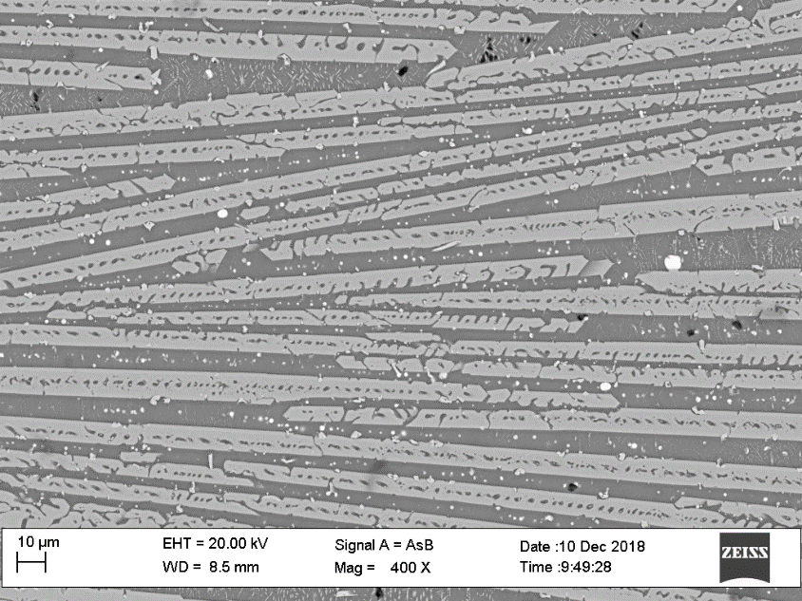
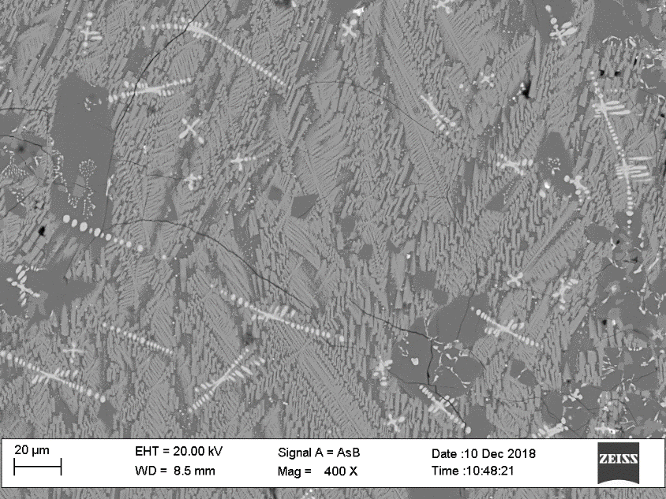
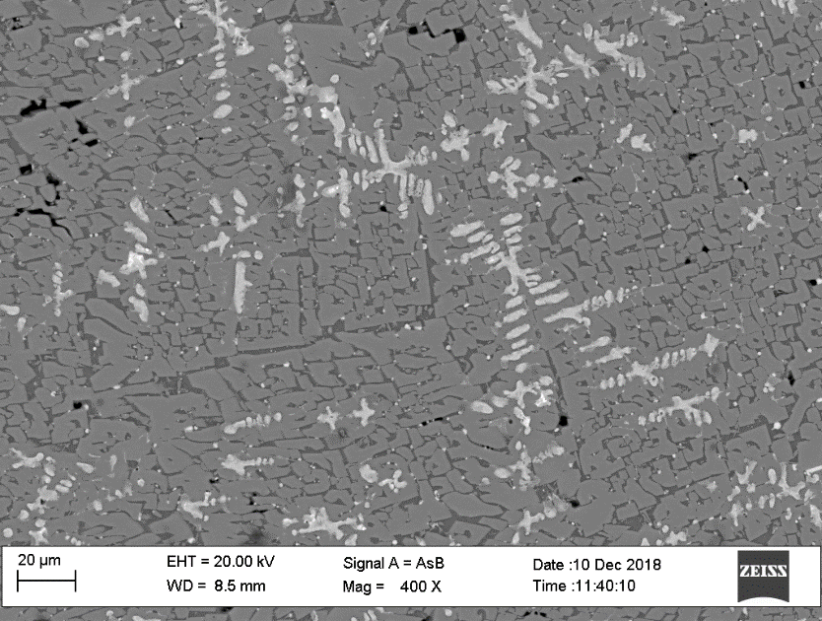
Results – SEM-EDS
Sample C5 | Sample C15 | Sample C25
Main phases: 1. Fe, Si, Mg, O 2. Si, Ca, Fe, Al, O – (Cu, S, Sb, As) Inclusions | Main phases: 2. Si, Ca, Fe, Al, O - (Cu, S, Sb, As) 3. Fe, Si, Ca, Mg, O 4. Fe, O | Main phases: 2. Si, Ca, Fe, Al, O - (Cu, S, Sb, As) 4. Fe, O 5. Ca, Si, Fe, Mg, O
2
3
4
2
4
2
5
1

Slide 11
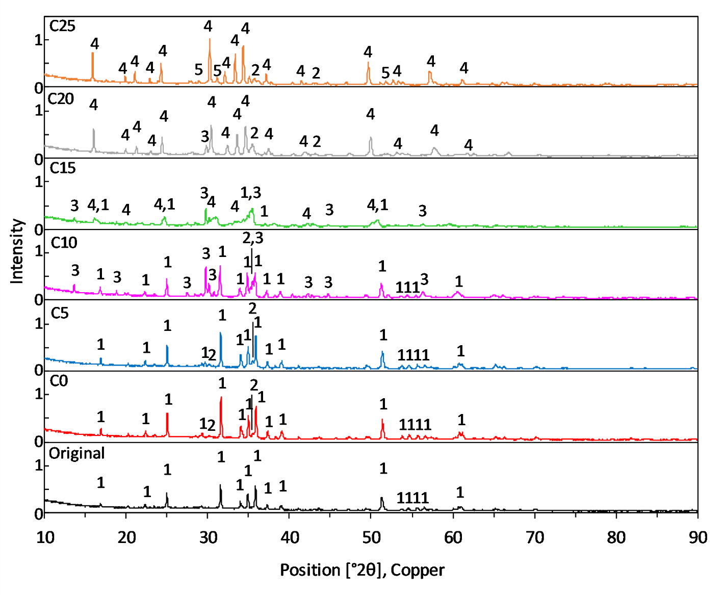
Results – X-ray diffraction
Mineral phases identified
1. Fe₂SiO₄ | Fayalite
2. Fe₃O₄ | Magnetite
3. CaFeSi₂O₆ | Hedenbergite
4. CaFeSiO₄ | Kirschstenite
5. Ca₂FeSi₂O₇ | Åkermanite
Increasing CaO content

Slide 12
Results - Leaching

Slide 13
Results – Batch leaching test
pH | Conductivity
pH increases from 9.6 to 10.5 increasing amounts of available Ca. | Conductivity increasing to 62 µS/cm Generally low values, below tap water. < 2500 µS/cm

Slide 14
Results – Batch leaching test
Copper | Antimony | Arsenic
Copper decrease: ~56 % | C15: ~3 times C0 | C15: ~3 times C0

Slide 15
Summary
CaO addition changed the slag mineralogy of crystalline slag samples
Fe₂SiO₄ → CaFeSi₂O₆ (transition area)→ CaFeSiO₄
Leachability of Cu decrease from the slag product.
The leaching of Sb and As was highest at the transition area, CaFeSi₂O₆
Iron oxide precipitates in slag with higher CaO addition (20-25 wt.%).

Slide 16
Acknowledgements
Project partners:
Luleå University of technology
Boliden Mineral AB
PEAB Anläggning AB
Xore AB
Nordkalk AB

Slide 17
Thank you for your attention!
Contact details:
Jakob Kero
Jakob.kero@ltu.se
Ph.D. student in Process Metallurgy,
Luleå University of technology, Sweden

